Slide 1
Number system - 6
Properties of factors
Linear equations

Slide 2
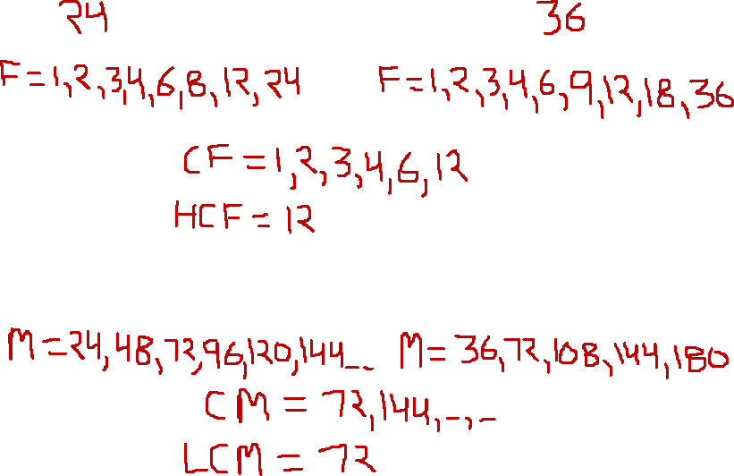
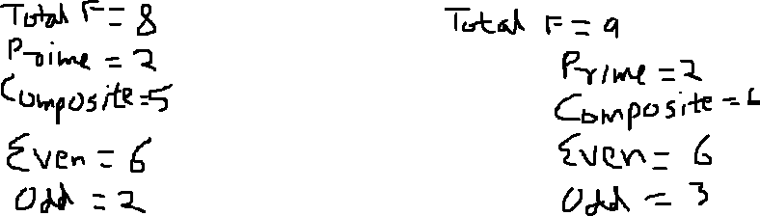
Factors & Multiples of 2 numbers

Slide 3
Factors & Multiples
So, it is clear we can find multiples of any number k, easily as k, 2k, 3k, 4k… and so on
But, we cannot find factors so easily and so we need to use properties of factors
We need to express a number in its prime factorization form to find the factors ( and to discuss properties of factors)

Slide 4
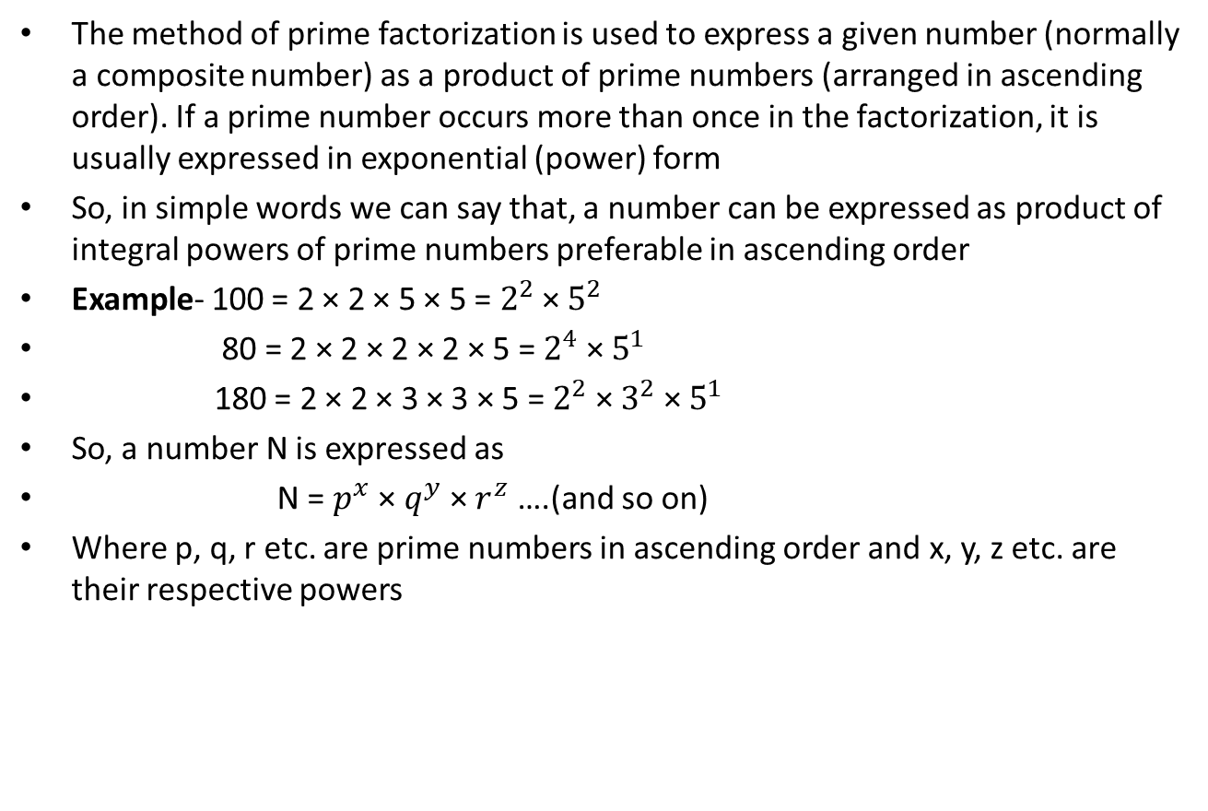
Prime Factorization
The method of prime factorization is used to express a given number (normally a composite number) as a product of prime numbers (arranged in ascending order). If a prime number occurs more than once in the factorization, it is usually expressed in exponential (power) form
So, in simple words we can say that, a number can be expressed as product of integral powers of prime numbers preferable in ascending order
Example- 100 = 2 × 2 × 5 × 5 = $2^{2}$ × $5^{2}$
80 = 2 × 2 × 2 × 2 × 5 = $2^{4}$ × $5^{1}$
180 = 2 × 2 × 3 × 3 × 5 = $2^{2}$ × $3^{2}$ × $5^{1}$
So, a number N is expressed as
N = $p^{x}$ × $q^{y}$ × $r^{z}$ ….(and so on)
Where p, q, r etc. are prime numbers in ascending order and x, y, z etc. are their respective powers

Slide 5
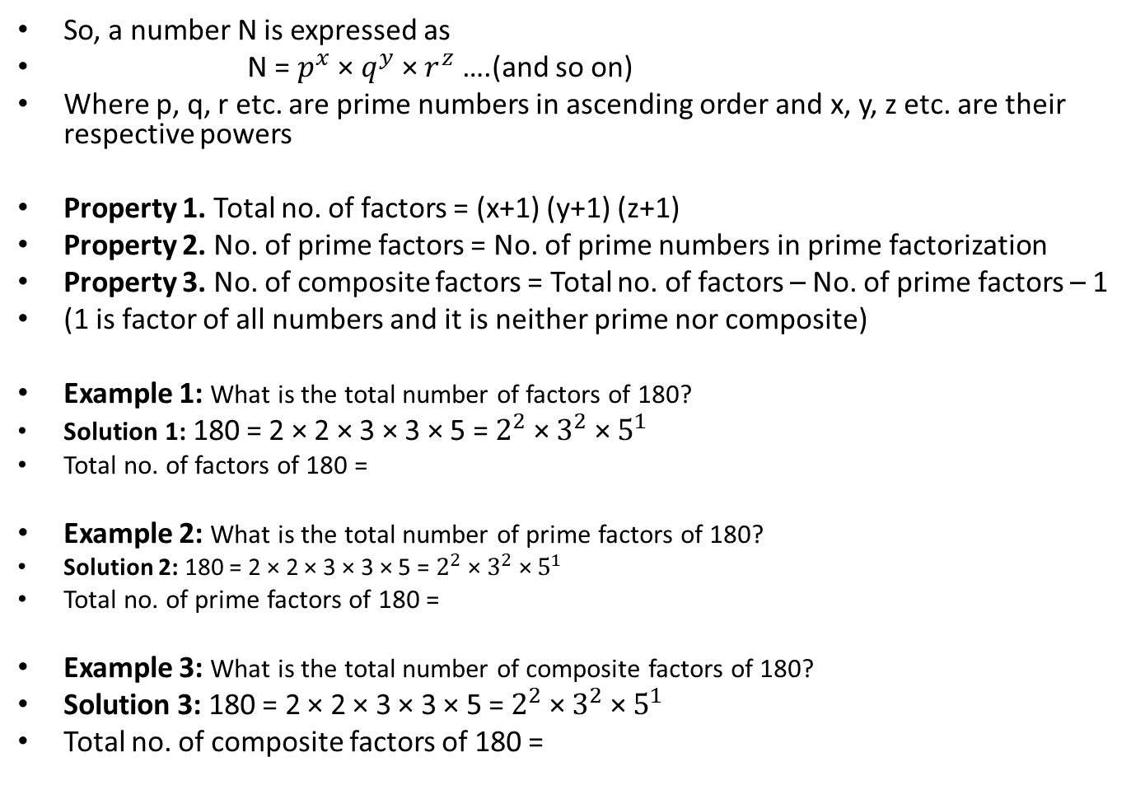
Properties of Factors
So, a number N is expressed as
N = $p^{x}$ × $q^{y}$ × $r^{z}$ ….(and so on)
Where p, q, r etc. are prime numbers in ascending order and x, y, z etc. are their respective powers
Property 1. Total no. of factors = (x+1) (y+1) (z+1)
Property 2. No. of prime factors = No. of prime numbers in prime factorization
Property 3. No. of composite factors = Total no. of factors – No. of prime factors – 1
(1 is factor of all numbers and it is neither prime nor composite)
Example 1: What is the total number of factors of 180?
Solution 1: 180 = 2 × 2 × 3 × 3 × 5 = $2^{2}$ × $3^{2}$ × $5^{1}$
Total no. of factors of 180 =
Example 2: What is the total number of prime factors of 180?
Solution 2: 180 = 2 × 2 × 3 × 3 × 5 = $2^{2}$ × $3^{2}$ × $5^{1}$
Total no. of prime factors of 180 =
Example 3: What is the total number of composite factors of 180?
Solution 3: 180 = 2 × 2 × 3 × 3 × 5 = $2^{2}$ × $3^{2}$ × $5^{1}$
Total no. of composite factors of 180 =

Slide 6
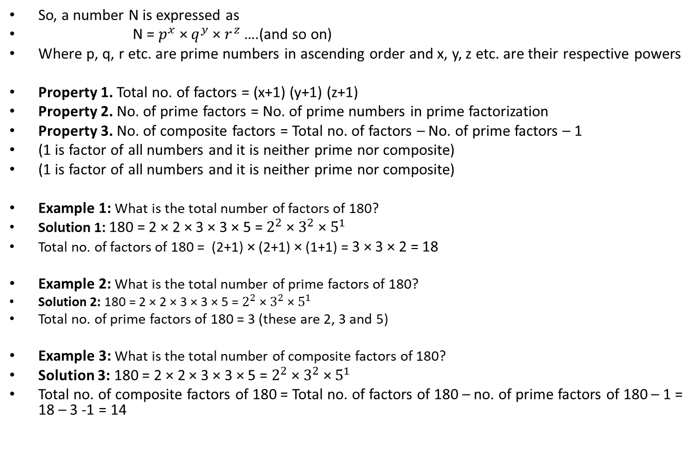
Properties of Factors
So, a number N is expressed as
N = $p^{x}$ × $q^{y}$ × $r^{z}$ ….(and so on)
Where p, q, r etc. are prime numbers in ascending order and x, y, z etc. are their respective powers
Property 1. Total no. of factors = (x+1) (y+1) (z+1)
Property 2. No. of prime factors = No. of prime numbers in prime factorization
Property 3. No. of composite factors = Total no. of factors – No. of prime factors – 1
(1 is factor of all numbers and it is neither prime nor composite)
(1 is factor of all numbers and it is neither prime nor composite)
Example 1: What is the total number of factors of 180?
Solution 1: 180 = 2 × 2 × 3 × 3 × 5 = $2^{2}$ × $3^{2}$ × $5^{1}$
Total no. of factors of 180 = (2+1) × (2+1) × (1+1) = 3 × 3 × 2 = 18
Example 2: What is the total number of prime factors of 180?
Solution 2: 180 = 2 × 2 × 3 × 3 × 5 = $2^{2}$ × $3^{2}$ × $5^{1}$
Total no. of prime factors of 180 = 3 (these are 2, 3 and 5)
Example 3: What is the total number of composite factors of 180?
Solution 3: 180 = 2 × 2 × 3 × 3 × 5 = $2^{2}$ × $3^{2}$ × $5^{1}$
Total no. of composite factors of 180 = Total no. of factors of 180 – no. of prime factors of 180 – 1 = 18 – 3 -1 = 14

Slide 7
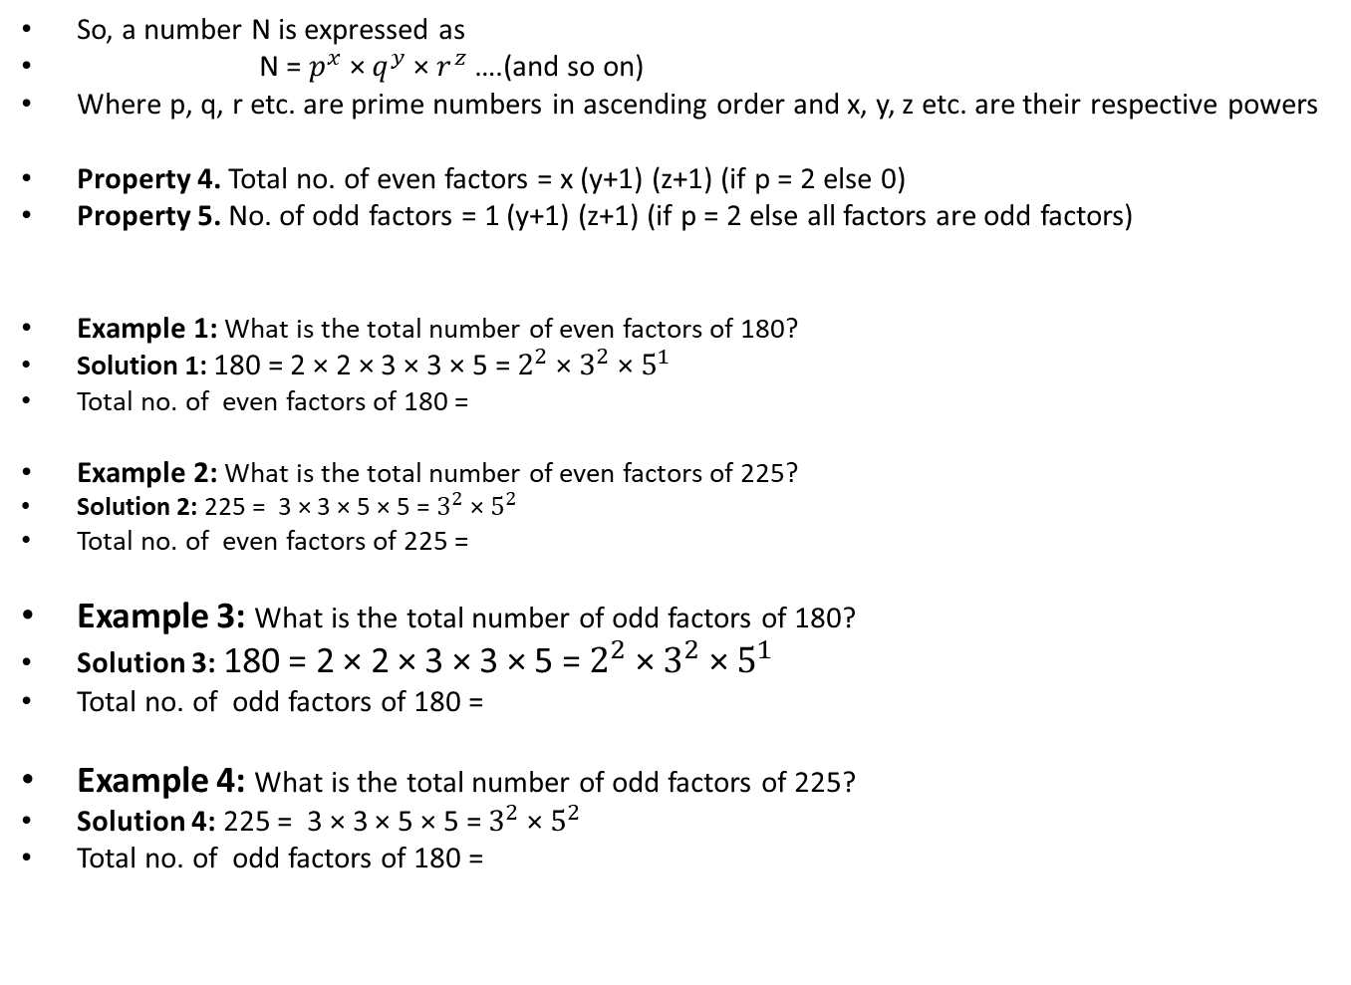
Properties of Factors
So, a number N is expressed as
N = $p^{x}$ × $q^{y}$ × $r^{z}$ ….(and so on)
Where p, q, r etc. are prime numbers in ascending order and x, y, z etc. are their respective powers
Property 4. Total no. of even factors = x (y+1) (z+1) (if p = 2 else 0)
Property 5. No. of odd factors = 1 (y+1) (z+1) (if p = 2 else all factors are odd factors)
Example 1: What is the total number of even factors of 180?
Solution 1: 180 = 2 × 2 × 3 × 3 × 5 = $2^{2}$ × $3^{2}$ × $5^{1}$
Total no. of even factors of 180 =
Example 2: What is the total number of even factors of 225?
Solution 2: 225 = 3 × 3 × 5 × 5 = $3^{2}$ × $5^{2}$
Total no. of even factors of 225 =
Example 3: What is the total number of odd factors of 180?
Solution 3: 180 = 2 × 2 × 3 × 3 × 5 = $2^{2}$ × $3^{2}$ × $5^{1}$
Total no. of odd factors of 180 =
Example 4: What is the total number of odd factors of 225?
Solution 4: 225 = 3 × 3 × 5 × 5 = $3^{2}$ × $5^{2}$
Total no. of odd factors of 180 =

Slide 8
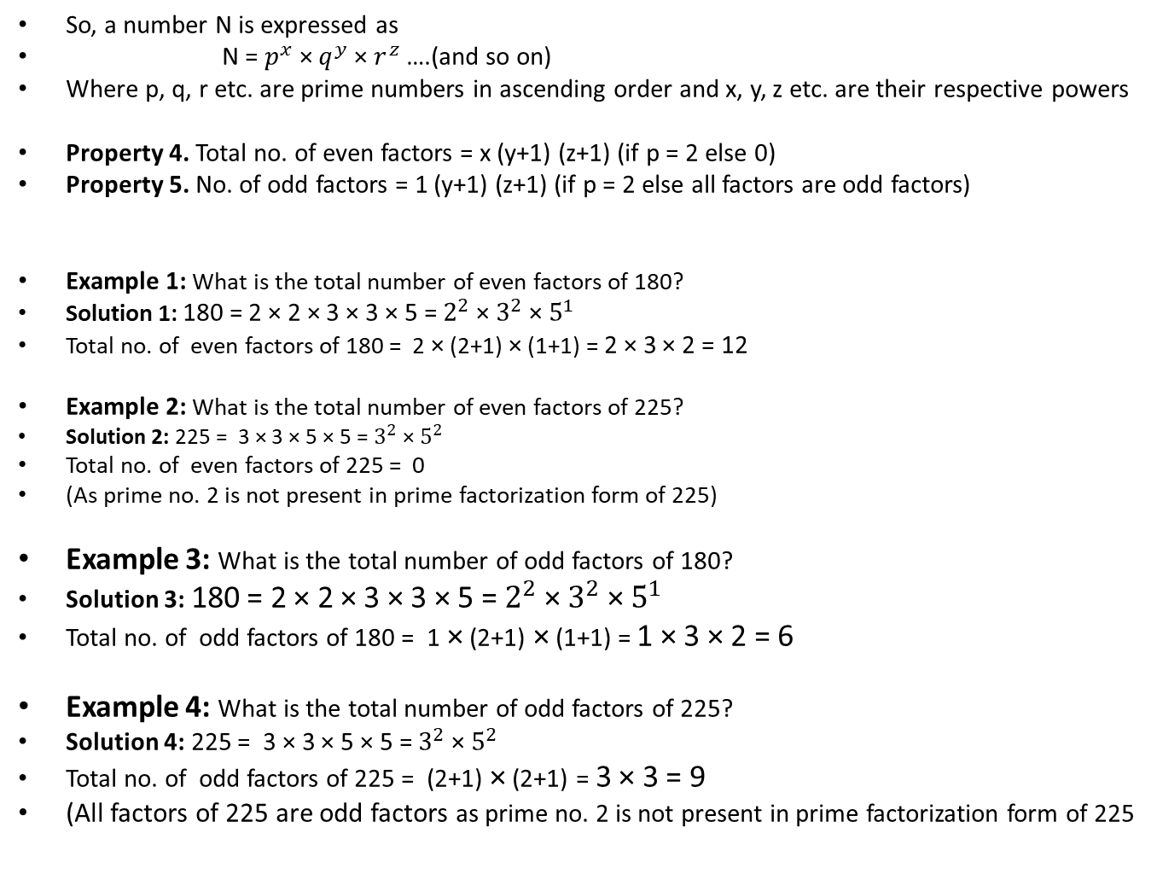
Properties of Factors
So, a number N is expressed as
N = $p^{x}$ × $q^{y}$ × $r^{z}$ ….(and so on)
Where p, q, r etc. are prime numbers in ascending order and x, y, z etc. are their respective powers
Property 4. Total no. of even factors = x (y+1) (z+1) (if p = 2 else 0)
Property 5. No. of odd factors = 1 (y+1) (z+1) (if p = 2 else all factors are odd factors)
Example 1: What is the total number of even factors of 180?
Solution 1: 180 = 2 × 2 × 3 × 3 × 5 = $2^{2}$ × $3^{2}$ × $5^{1}$
Total no. of even factors of 180 = 2 × (2+1) × (1+1) = 2 × 3 × 2 = 12
Example 2: What is the total number of even factors of 225?
Solution 2: 225 = 3 × 3 × 5 × 5 = $3^{2}$ × $5^{2}$
Total no. of even factors of 225 = 0
(As prime no. 2 is not present in prime factorization form of 225)
Example 3: What is the total number of odd factors of 180?
Solution 3: 180 = 2 × 2 × 3 × 3 × 5 = $2^{2}$ × $3^{2}$ × $5^{1}$
Total no. of odd factors of 180 = 1 × (2+1) × (1+1) = 1 × 3 × 2 = 6
Example 4: What is the total number of odd factors of 225?
Solution 4: 225 = 3 × 3 × 5 × 5 = $3^{2}$ × $5^{2}$
Total no. of odd factors of 225 = (2+1) × (2+1) = 3 × 3 = 9
(All factors of 225 are odd factors as prime no. 2 is not present in prime factorization form of 225

Slide 9
Simple problems on properties of factors
1. What is the total number of even factors of 380?
2. What is the total number of factors of 2400?
3. What is the total number of odd factors of 750?
4. What is the total number of prime factors of 21000?
5. What is the total number of composite factors of 1500?

Slide 10
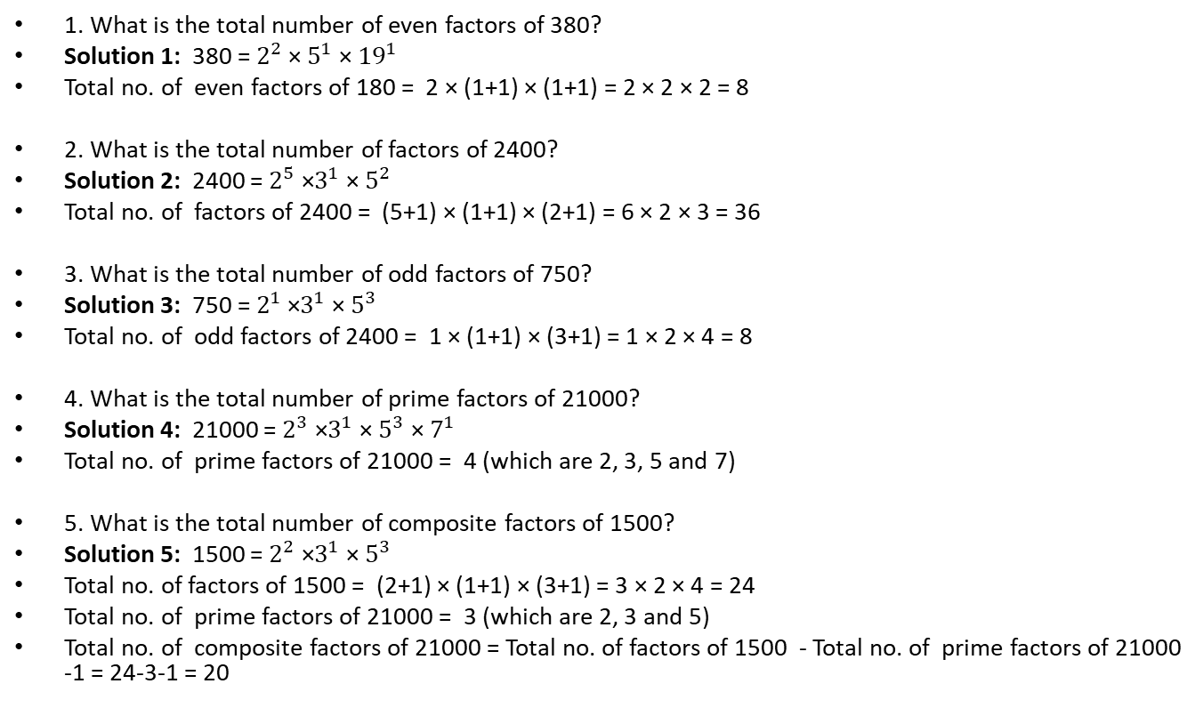
Simple problems on properties of factors
1. What is the total number of even factors of 380?
Solution 1: 380 = $2^{2}$ × $5^{1}$ × ${19}^{1}$
Total no. of even factors of 180 = 2 × (1+1) × (1+1) = 2 × 2 × 2 = 8
2. What is the total number of factors of 2400?
Solution 2: 2400 = $2^{5}$ ×$3^{1}$ × $5^{2}$
Total no. of factors of 2400 = (5+1) × (1+1) × (2+1) = 6 × 2 × 3 = 36
3. What is the total number of odd factors of 750?
Solution 3: 750 = $2^{1}$ ×$3^{1}$ × $5^{3}$
Total no. of odd factors of 2400 = 1 × (1+1) × (3+1) = 1 × 2 × 4 = 8
4. What is the total number of prime factors of 21000?
Solution 4: 21000 = $2^{3}$ ×$3^{1}$ × $5^{3}$ × $7^{1}$
Total no. of prime factors of 21000 = 4 (which are 2, 3, 5 and 7)
5. What is the total number of composite factors of 1500?
Solution 5: 1500 = $2^{2}$ ×$3^{1}$ × $5^{3}$
Total no. of factors of 1500 = (2+1) × (1+1) × (3+1) = 3 × 2 × 4 = 24
Total no. of prime factors of 21000 = 3 (which are 2, 3 and 5)
Total no. of composite factors of 21000 = Total no. of factors of 1500 - Total no. of prime factors of 21000 -1 = 24-3-1 = 20

Slide 11
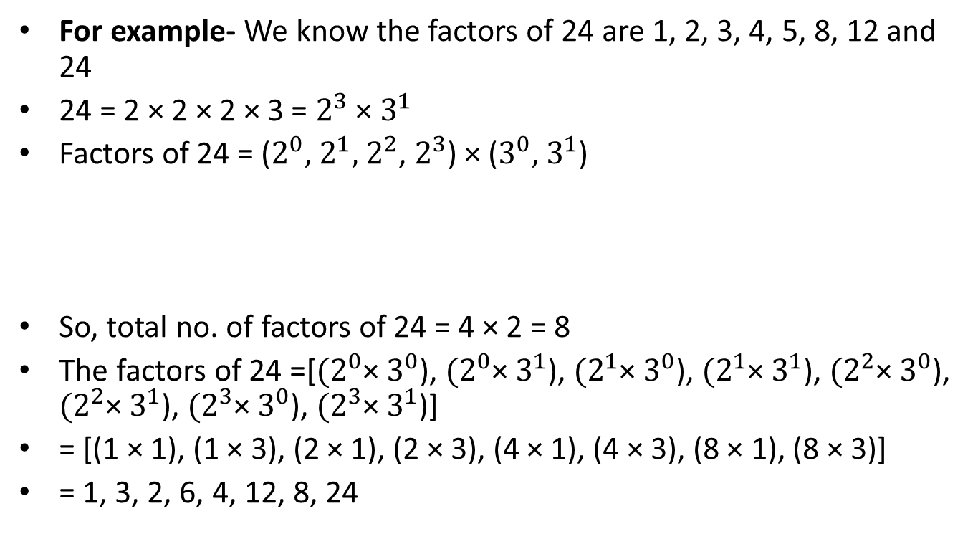
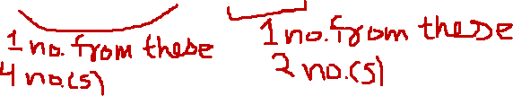
Example- How to find individual factors of a number- not part of syllabus
For example- We know the factors of 24 are 1, 2, 3, 4, 5, 8, 12 and 24
24 = 2 × 2 × 2 × 3 = $2^{3}$ × $3^{1}$
Factors of 24 = ($2^{0},$ $2^{1},$ $2^{2}$, $2^{3}$) × ($3^{0},$ $3^{1}$)
So, total no. of factors of 24 = 4 × 2 = 8
The factors of 24 =[${(2}^{0}$× $3^{0}$), ${(2}^{0}$× $3^{1}$), ${(2}^{1}$× $3^{0}$), ${(2}^{1}$× $3^{1}$), ${(2}^{2}$× $3^{0}$), ${(2}^{2}$× $3^{1}$), ${(2}^{3}$× $3^{0}$), ${(2}^{3}$× $3^{1}$)]
= [(1 × 1), (1 × 3), (2 × 1), (2 × 3), (4 × 1), (4 × 3), (8 × 1), (8 × 3)]
= 1, 3, 2, 6, 4, 12, 8, 24

Slide 12
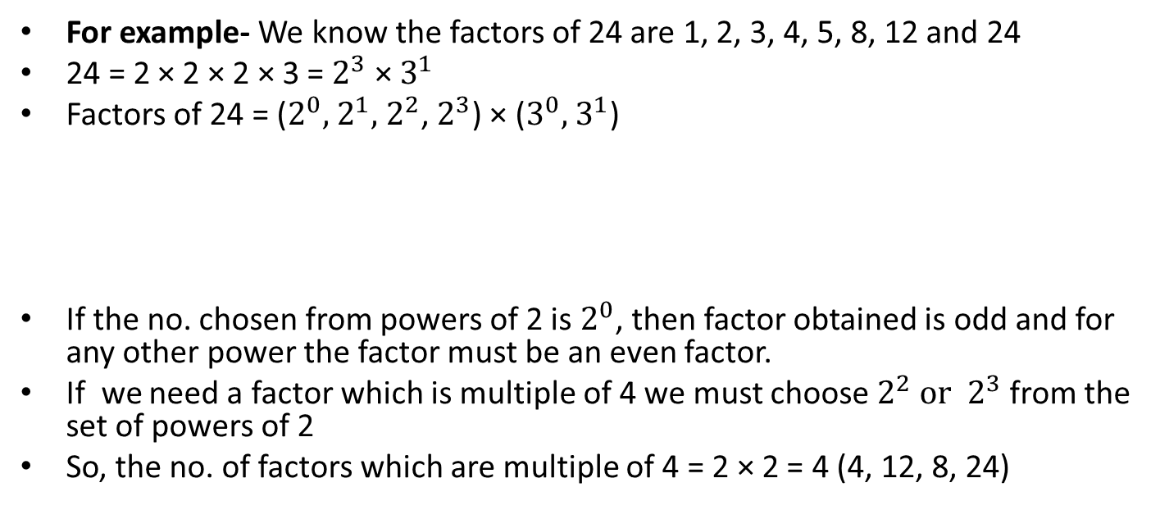
Special cases- not part of syllabus
For example- We know the factors of 24 are 1, 2, 3, 4, 5, 8, 12 and 24
24 = 2 × 2 × 2 × 3 = $2^{3}$ × $3^{1}$
Factors of 24 = ($2^{0},$ $2^{1},$ $2^{2}$, $2^{3}$) × ($3^{0},$ $3^{1}$)
If the no. chosen from powers of 2 is $2^{0}$, then factor obtained is odd and for any other power the factor must be an even factor.
If we need a factor which is multiple of 4 we must choose $2^{2} or$ $2^{3}$ from the set of powers of 2
So, the no. of factors which are multiple of 4 = 2 × 2 = 4 (4, 12, 8, 24)

Slide 13
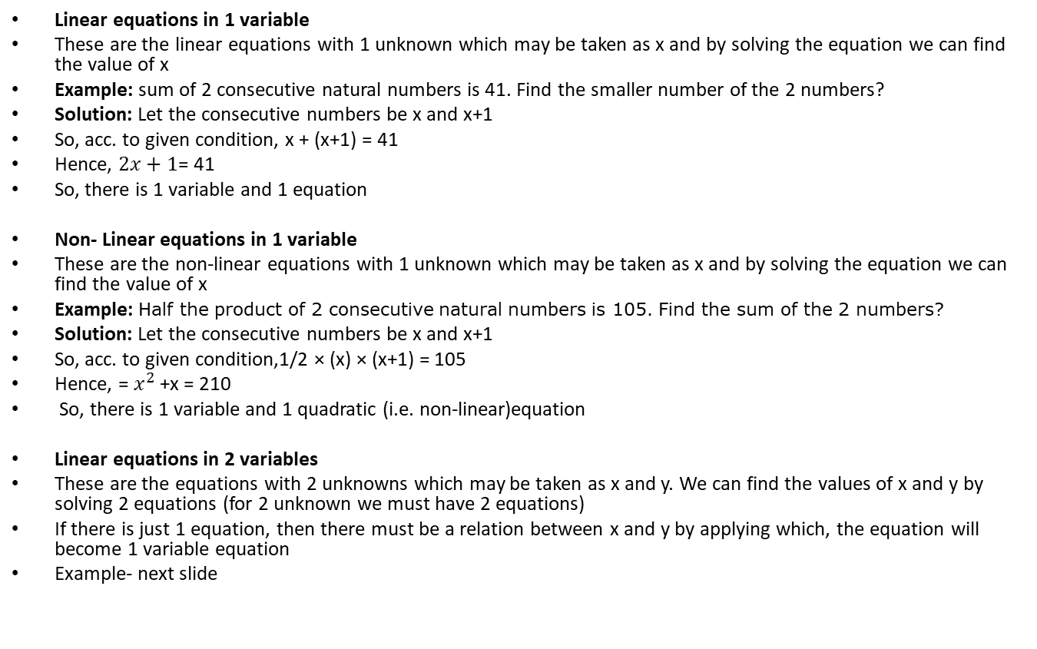
Linear equations in 1 and 2 variable(s)
Linear equations in 1 variable
These are the linear equations with 1 unknown which may be taken as x and by solving the equation we can find the value of x
Example: sum of 2 consecutive natural numbers is 41. Find the smaller number of the 2 numbers?
Solution: Let the consecutive numbers be x and x+1
So, acc. to given condition, x + (x+1) = 41
Hence, $2x+1$= 41
So, there is 1 variable and 1 equation
Non- Linear equations in 1 variable
These are the non-linear equations with 1 unknown which may be taken as x and by solving the equation we can find the value of x
Example: Half the product of 2 consecutive natural numbers is 105. Find the sum of the 2 numbers?
Solution: Let the consecutive numbers be x and x+1
So, acc. to given condition,1/2 × (x) × (x+1) = 105
Hence, = $x^{2}$ +x = 210
So, there is 1 variable and 1 quadratic (i.e. non-linear)equation
Linear equations in 2 variables
These are the equations with 2 unknowns which may be taken as x and y. We can find the values of x and y by solving 2 equations (for 2 unknown we must have 2 equations)
If there is just 1 equation, then there must be a relation between x and y by applying which, the equation will become 1 variable equation
Example- next slide

Slide 14
Linear equations in 1 and 2 variable(s)
Linear equations in 2 variables
These are the equations with 2 unknowns which may be taken as x and y. We can find the values of x and y by solving 2 equations (for 2 unknown we must have 2 equations)
If there is just 1 equation, then there must be a relation between x and y by applying which, the equation will become 1 variable equation
Example 1: The sum of a 2-digit number and the number obtained by reversing the digits is 55. If the digit in the ten’s place is one more than the digit in the unit’s place, find the remainder when the number is divided by 4?
a. 0 b. 1 c. 2 d. 3
Example 2: A farmer decides to plant saplings in rows such that each row has the same number of saplings. If he plants 5 more saplings per row, the number of rows required will reduce by 5. If the number of rows initially required is 1 more than twice the number of saplings planted per row, find the total number of saplings?
a. 9 b.40 c. 36 d. 24

Slide 15
Linear equations in 1 and 2 variable(s)
Linear equations in 2 variables
These are the equations with 2 unknowns which may be taken as x and y. We can find the values of x and y by solving 2 equations (for 2 unknown we must have 2 equations)
If there is just 1 equation, then there must be a relation between x and y by applying which, the equation will become 1 variable equation
Example 1: The sum of a 2-digit number and the number obtained by reversing the digits is 55. If the digit in the ten’s place is one more than the digit in the unit’s place, find the remainder when the number is divided by 4?
a. 0 b. 1 c. 2 d. 3
Solution 1: Any number xy is 10x + y (for e.g. 32 = 3 × 10 + 2)
Let, the original number be xy = 10x + y. The number obtained by reversing the digits is yx = 10y + x
ATGC, xy + yx = 55
So, 10 x + y + 10y + x = 55
So, 11 (x + y) = 55
So, x + y = 55……………………(1)
This is 1 equation and 2 variable and so cannot be solved u less there is some relation between variables.
We know that the digit in the ten’s place is one more than the digit in the unit’s place.
So, x = y + 1
So, (y+1) + y = 5
Hence, y = 2 and x = 3
So, the number xy = 32
The remainder when xy divided by 4 = 32/4 = 0
Required remainder = 0

Slide 16
Linear equations in 1 and 2 variable(s)
Example 2: A farmer decides to plant saplings in rows such that each row has the same number of saplings. If he plants 5 more saplings per row, the number of rows required will reduce by 5. If the number of rows initially required is 1 more than twice the number of saplings planted per row, find the total number of saplings?
a. 9 b.40 c. 36 d. 24
Solution 2- Let x = number of rows
y = number of saplings per row
So, total number of saplings = xy……………………………………(1)
. If he plants 5 more saplings per row, the number of rows required will reduce by 5.
Hence, y’ = y+5
x’ = x-5
Now, number of saplings = x’y’………………………………………..(2)
So, Number of saplings = xy = x’y’ = (x-5)(y+5)
So, xy = (x-5)(y+5)
Solving it we get, x-y = 5…………………………………………………(3)
the number of rows initially required is 1 more than twice the number of saplings planted per row
So, x = 2y + 1
Hence, 2y+1-y = 5
So, y = 4 and x=9
Total number of saplings = xy = 9 × 4 = 36

